Slide 1
PRAGATI BUS MANAGEMENT

Slide 2
INTRODUCTION
Pragati Bus Management is a system designed to make bus transportation more organized, reliable, and passenger-friendly. By using modern tools like GPS tracking, digital ticketing, and efficient route planning, it ensures safe travel, reduces delays, and improves overall service quality.

Slide 3
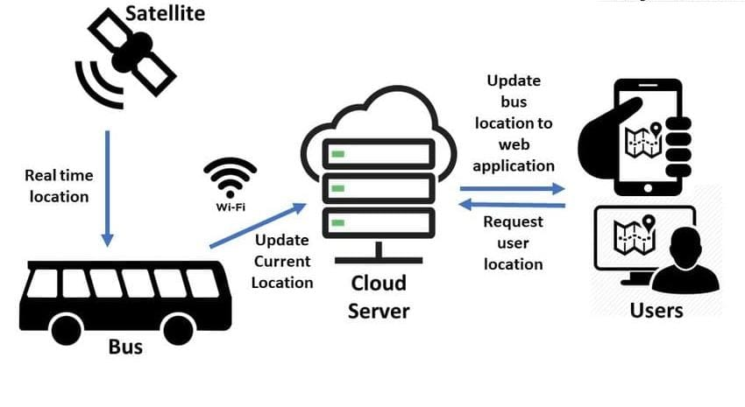
WHAT IS BUS MANAGEMENT
Bus management refers to the organized system of planning, operating, and monitoring bus services to ensure safe, efficient, and reliable transportation for passengers. It covers everything from scheduling routes and maintaining buses to ticketing, staff management, and passenger satisfaction.

Slide 4
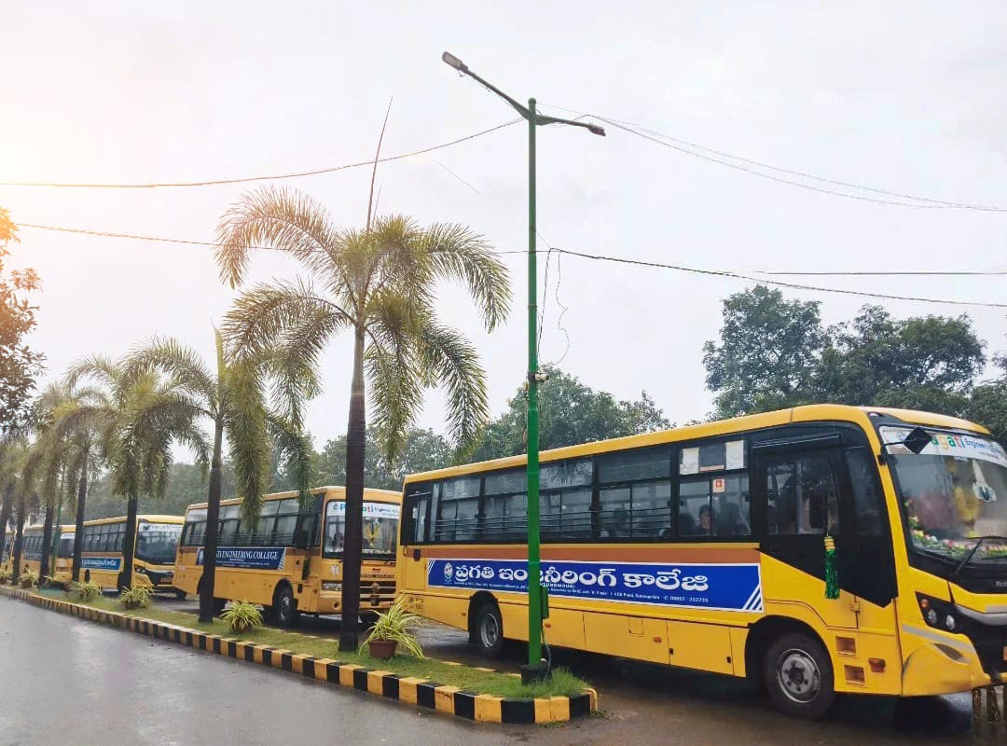
WHY PRAGATI BUS MANAGEMENT USEFUL
Pragati Bus Management is a modern system that makes bus services more reliable and efficient. It uses smart scheduling and GPS tracking to ensure punctuality and passenger safety. Digital ticketing provides convenience and transparency in travel. Efficient fleet management reduces fuel costs and maintenance issues. Overall, it creates an organized, eco‑friendly, and passenger‑friendly transport network.

Slide 5
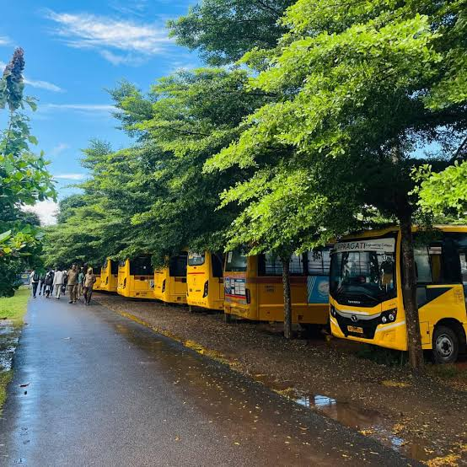
OBJECTIVE OF PRAGATI BUS MANAGEMENT
The objective of Pragati Bus Management is to make bus transport safe, reliable, and efficient. It focuses on improving punctuality through smart scheduling, ensuring passenger safety with GPS tracking, and offering convenience with digital ticketing. By optimizing resources and promoting eco‑friendly practices, it reduces costs and congestion. Overall, its aim is to provide organized, accessible, and passenger‑friendly services for both urban and rural communities.

Slide 6
HOW ARRAYS ARE IN THIS IN PROJECT
In this program, arrays are used to store and manage multiple records of the same type efficiently. The arrays buses[MAX_BUSES], drivers[MAX_DRIVERS], and trips[100] are arrays of structures, where each element represents one complete bus, driver, or trip record. Instead of handling only one bus or driver, these arrays allow the system to manage an entire fleet and multiple drivers at the same time. The integer variables bus_count, driver_count, and trip_count keep track of how many elements in each array are currently in use. Functions like add_bus(), add_driver(), and display_fleet_status() access these arrays using index values to add, update, and display data. Thus, arrays connect the structures to the program logic by enabling storage, retrieval, and manipulation of multiple related data records in an organized manner.

Slide 7
HOW STRUCTURES ARE USED IN THIS IN PROJECT
In this program, structures are used to combine related data of different data types into single meaningful units, making the code organized and easy to manage. The structures Bus, Driver, and Trip group together all information related to a bus, a driver, and a trip respectively, such as IDs, names, capacity, status, route, and fuel level. Each structure represents one real-world entity, and arrays of these structures are used to store multiple records. Functions in the program access structure members using the dot (.) operator to read and modify data, for example assigning a driver to a bus or displaying fleet details. Thus, structures form the core data model of the program by linking basic data types with real-world bus management concepts in a clear and structured way.

Slide 8
HOW LOOPS ARE USED IN THIS IN PROJECT
In this program, loops are used to repeatedly process and manage multiple records stored in arrays of structures. for loops are mainly used to traverse through the buses and drivers arrays to search for specific bus IDs or driver IDs and to display the complete fleet status. For example, in display_fleet_status(), a for loop prints details of every bus in the system, while in assign_driver(), loops are used to find matching records before assigning a driver. The while(1) loop in the main menu keeps the program running continuously until the user chooses to exit. Thus, loops connect the program logic with stored data by enabling repeated operations like searching, displaying, and updating multiple records efficiently.

Slide 9
HOW FUNCTIONS ARE USED IN THIS IN PROJECT
In this program, functions are used to divide the bus management system into smaller, well-defined tasks, making the code modular and easy to understand. Each function performs a specific operation such as initializing sample data, adding a bus, adding a driver, assigning a driver, displaying fleet status, or showing the main menu. These functions work on shared global data like the arrays of structures (buses, drivers, trips) and their counters, allowing data to be accessed and updated consistently throughout the program. The main_menu() function controls the overall flow by calling other functions based on the user’s choice, while main() simply starts the program. Thus, functions organize the program logic, improve readability, and make maintenance easier by separating different responsibilities into independent units.

Slide 10
CONCLUSION
The Pragati Bus Management System provides an efficient and organized way to manage bus fleet operations by integrating bus, driver, and trip information into a single system. By using structured programming concepts such as structures, arrays, functions, and loops, the system ensures systematic storage, easy retrieval, and effective management of data. It reduces manual effort, minimizes errors, and improves overall operational efficiency. This project demonstrates how basic programming concepts in C can be applied to solve real-world transportation management problems and serves as a strong foundation for developing more advanced, automated transport management systems in the future.

Slide 11
THANK YOU
TEAMATES:
PEMMANABOYINA BHUVANA CHANDRIKA - 25A31A04E9
PEMMANABOYINA KRISHNA MEGHANA - 25A31A04F0
KOLA LAKSHMI MANOHAR - 25A31A04I0
KORADA RAKESH - 25A31A04I1

